Slide 1
ESTIMATING AND COSTING
ELECTRICAL ENGG.

Slide 36
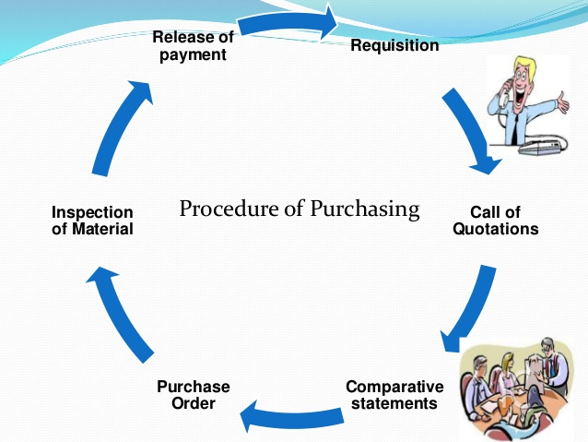

Slide 37
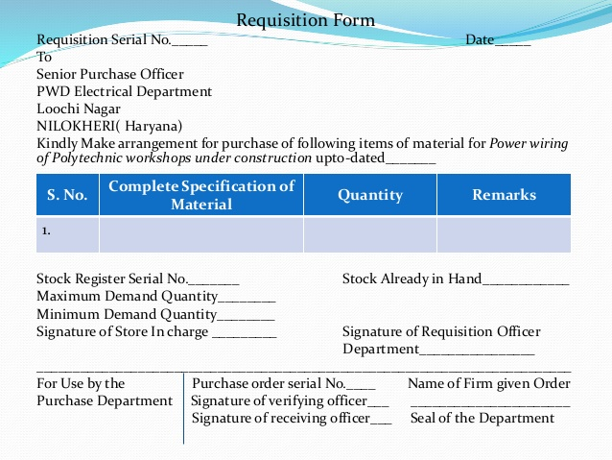

Slide 38
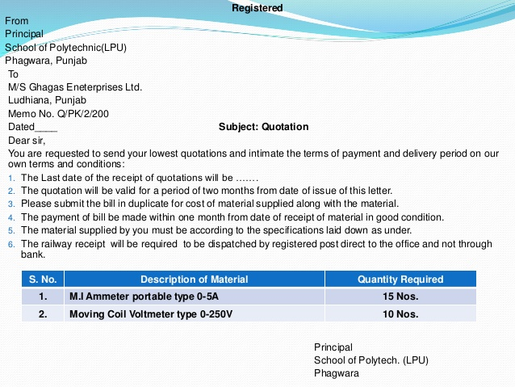

Slide 39
